Slide 1
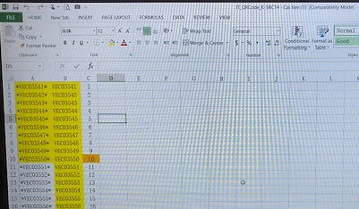
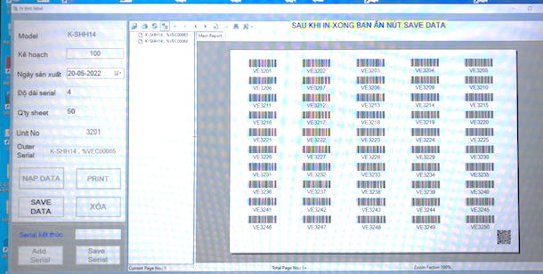
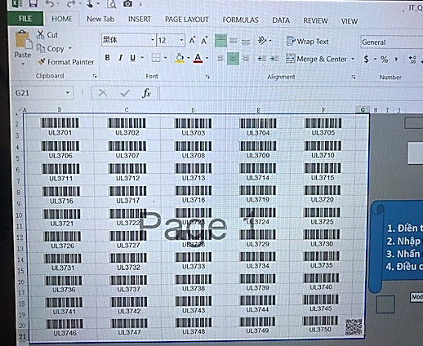
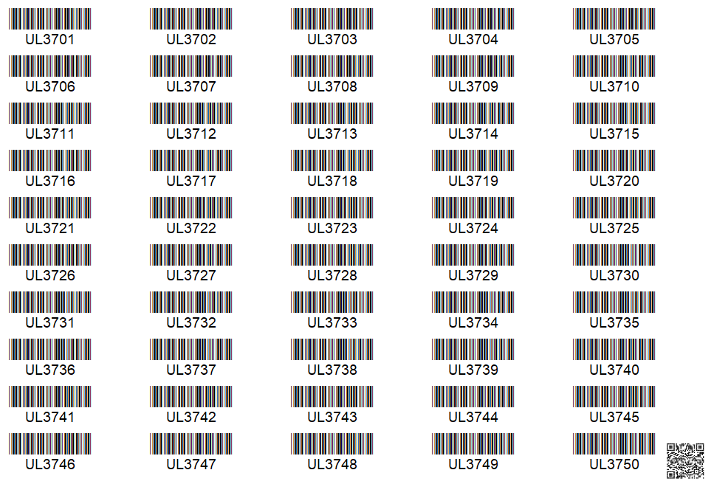
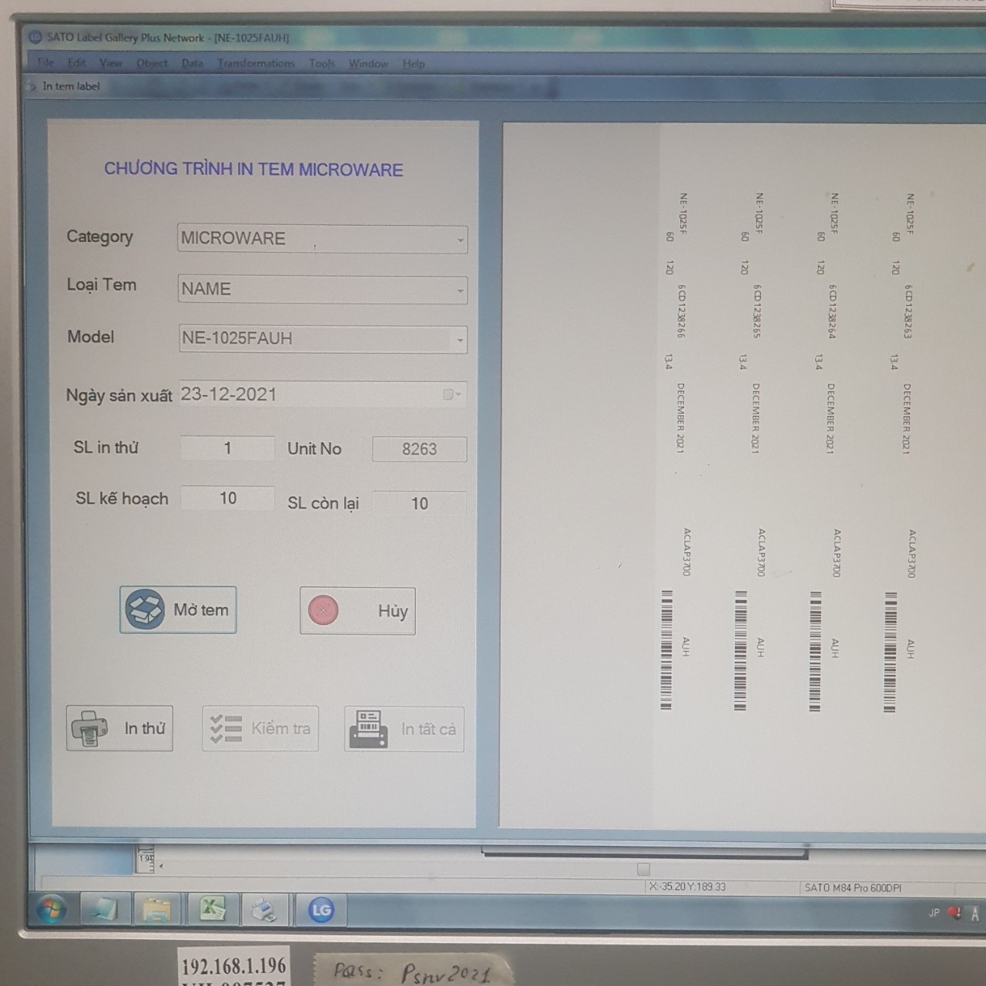
AUTOMATION PRINTING OUTER LABEL SB
1/1
Get serial number continue model by model from application.
Developer: NGUYEN THI THANH HOA
Apply: Jan-2022
Expn: 0
Ensure quality
◆Before
◆ After
Step 1: In put serial No into excel file
Choose Model
➔ Get serial number continue
Step 2: Create Barcode by Macro then printing
Manual input serial number
Separate file by model ( Total : 10 files )
Manual control serial number
Automation get serial number continue when choose model
Manual control serial number.
Easy to make mistake, wrong serial.
Automation get serial number continue.
Ensure quality.
Set up parameter
Year – month-date
of production date
Serial number
Year – month of production date : automation
Serial number : automation number continue
Notes:
Next theme, this is database daily checking improved by development team.

